Slide 1
BOOK A DOCTOR USING MERN STACK
PROJECT TITTLE
APPLICATION NAME : PRESCRIPTO
BY TEAM MEMBERS
K.NITHISHA
R.POOJA
P.MAHALAKSHMI
S.NIVETHA

Slide 3
ABSTRACT:
This project focuses on building a doctor booking system using the MERN stack, which consists of MongoDB, Express.js, React, and Node.js. The system allows patients to easily search for doctors based on their specialization, location, and availability, and book appointments in real-time.
Doctors can manage their schedules, view patient information, and confirm or reject appointment requests. By utilizing modern web technologies, this project aims to provide a streamlined, efficient, and user-friendly platform for both patients and healthcare providers.
The MERN stack offers a fast, scalable, and modern approach to full-stack web development. MongoDB ensures efficient data storage, Node.js and Express.js handle the server-side logic, while React.js provides a responsive and dynamic front-end experience. This project demonstrates the powerful combination of these technologies to create a practical and user-friendly doctor booking system.

Slide 4
INTRODUCATION :
This project focuses on building a doctor booking system using the MERN stack, which consists of MongoDB, Express.js, React, and Node.js.
The system allows patients to easily search for doctors based on their specialization, location, and availability, and book appointments in real-time. Doctors can manage their schedules, view patient information, and confirm or reject appointment requests.
By utilizing modern web technologies, this project aims to provide a streamlined, efficient, and user-friendly platform for both patients and healthcare providers.

Slide 5
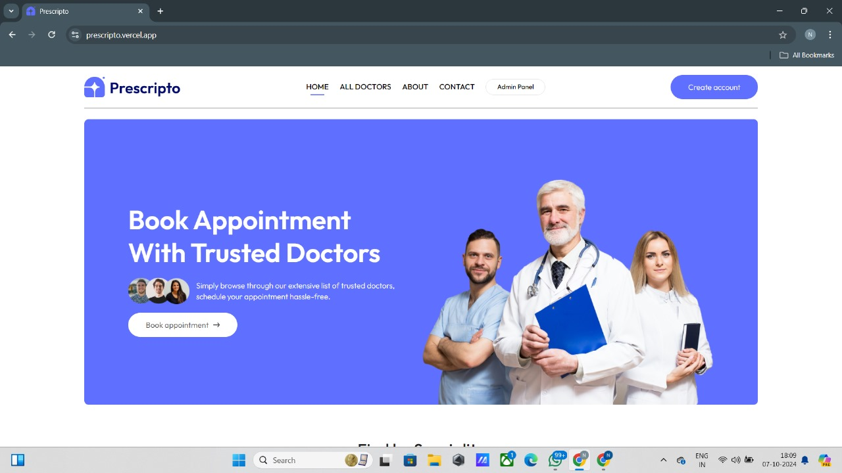
STEP 1: Open the prescripto website or webpage to book an appointment with the doctors

Slide 6
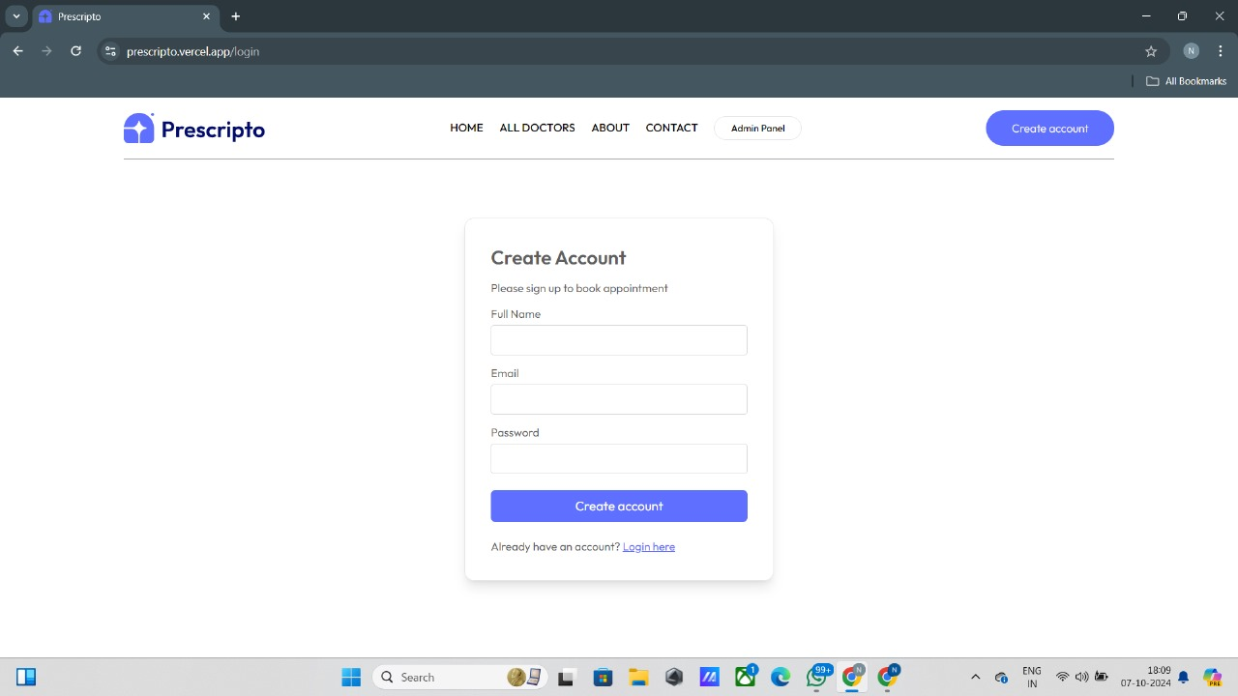
STEP 2: If you are a new user then first create an account page by using your mail id and name or login with your create mail id

Slide 7
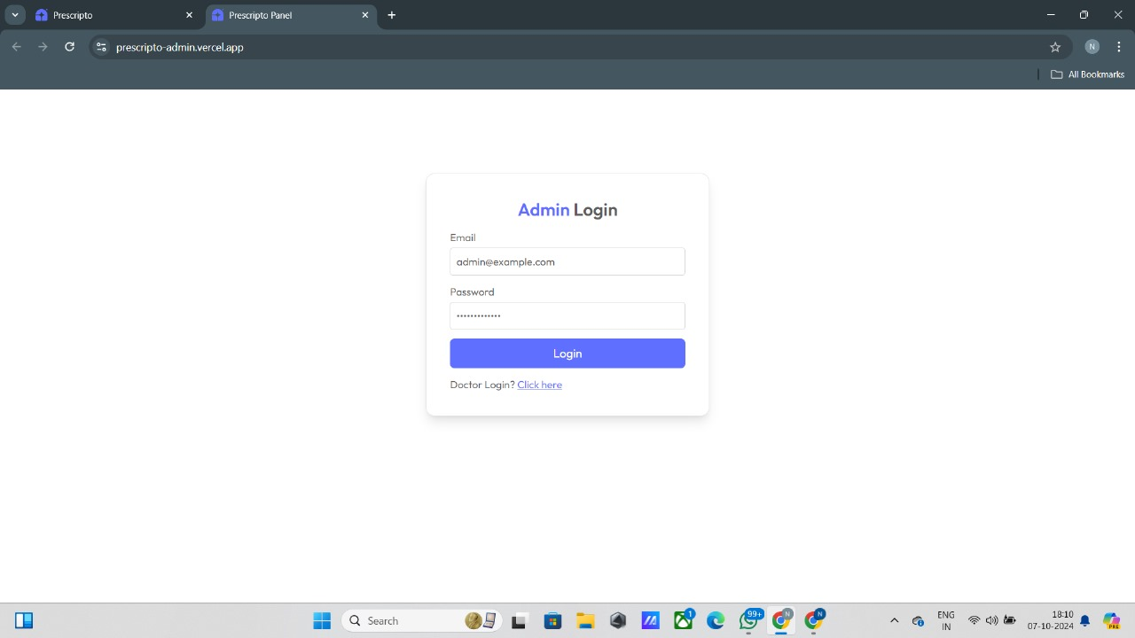
STEP 3: If you are a doctor click into the admin login page to enter into doctor's login site

Slide 8
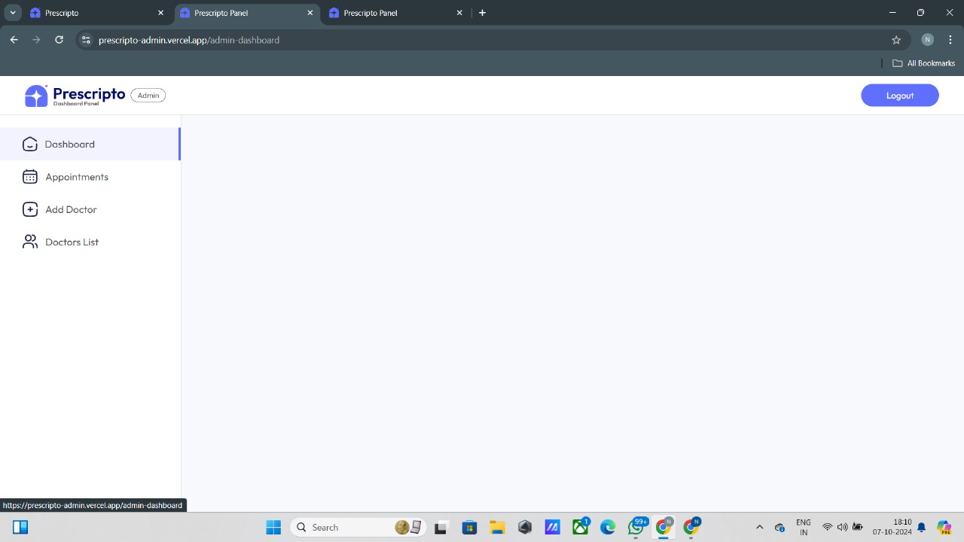
STEP 4 : After login your id, you can able to see the prescripto dashboard panel and their features

Slide 9
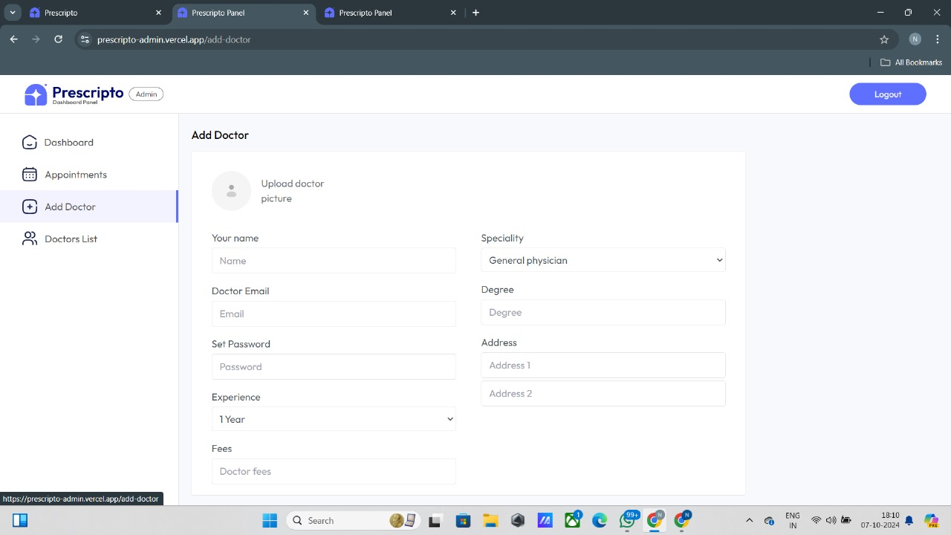
STEP 5:Next step is to add the doctor specialist in your page to know more about the doctor appointment and specialty

Slide 10
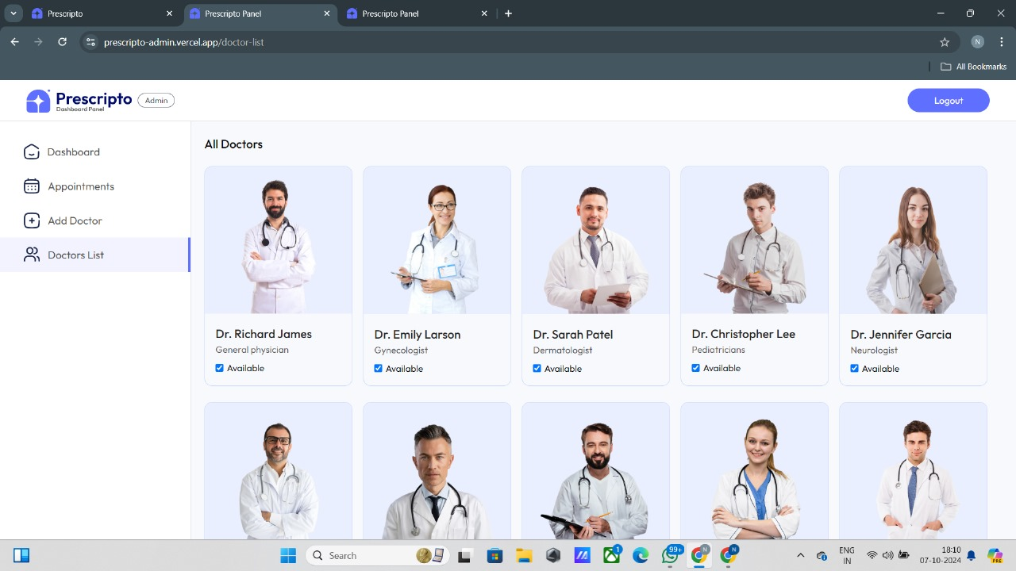
STEP 6:You can see the top class specialist in a list. In that list you can add your needed specialist in your add doctor Pannel

Slide 11
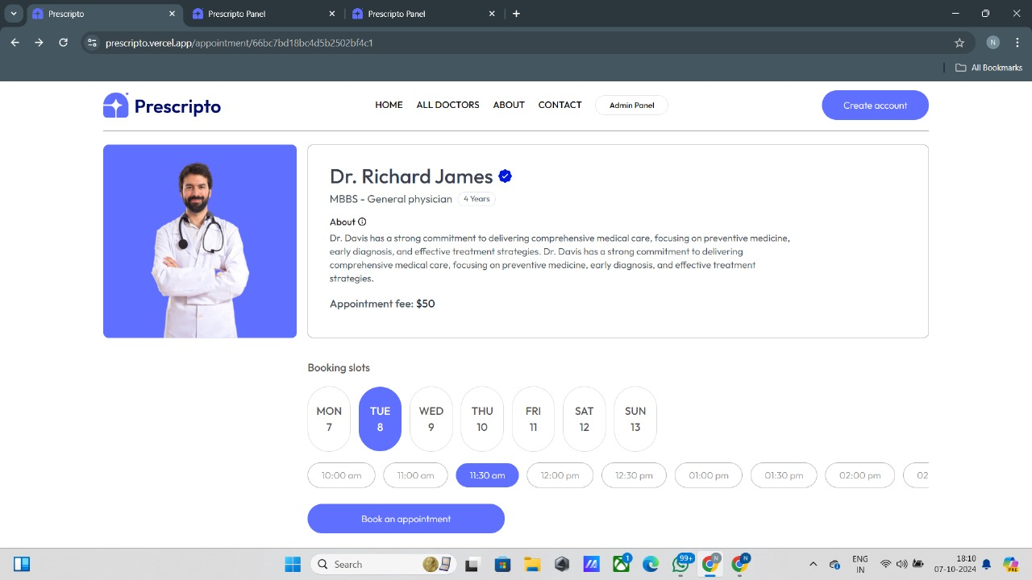
STEP 7:After add your doctor specialist in a list, you can able to book a doctor based on their booking slot and your schedule for your needed appointment

Slide 12
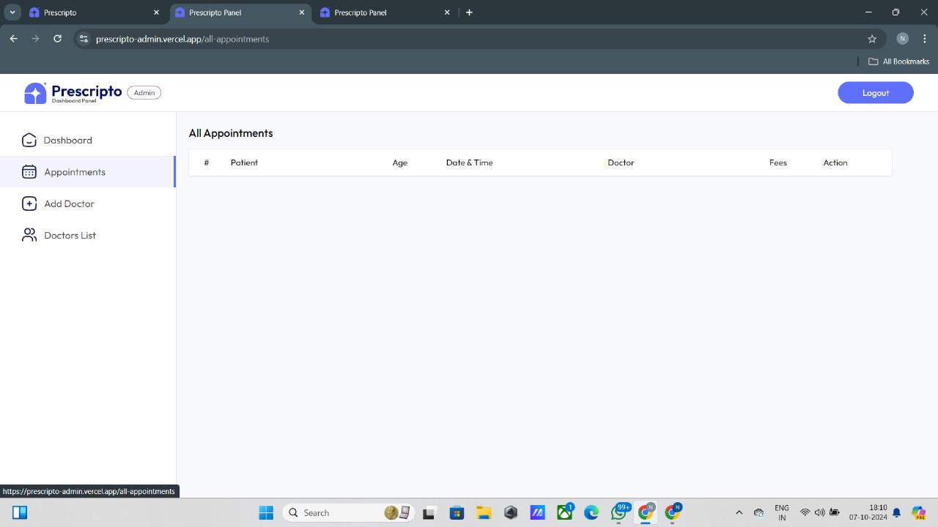
STEP 8:If you are in a doctor's login, you can see your patient details and their appointment for your treatment

Slide 13
CONCLUSION:
The "Book a Doctor" application built using the MERN stack provides a seamless, user-friendly platform for scheduling medical appointments. This solution is especially beneficial for elderly individuals and those with limited mobility, as it eliminates the need for physically visiting clinics just to book an appointment.
By allowing patients to connect with healthcare providers from the comfort of their homes, the application contributes to better time management, reduced travel stress, and quicker access to necessary medical services.
Overall, this application has the potential to greatly improve the healthcare experience for people of all ages, particularly the elderly and those in remote areas, contributing to a more efficient healthcare system.

